Slide 1
Capstone Project - The Battle of Neighborhoods
Restaurant Real-estate in Berlin

Slide 2
Restaurant real-estate listings in Berlin
It could be difficult to quickly assess the real-estate listings in a bigger city, such as Berlin if one isn’t familiar with every neighborhood
A person looking to open a restaurant may have an idea of the neighborhood profile they are looking for
Age profile of the resident and types of nearby venues should play a role in the decision process
Another factor could be the amount of competition in the neighborhood

Slide 3
Data sets and sources
Demographic data from December 31st 2021 split by postal codes and age ranges : https://www.statistik-berlin-brandenburg.de/publikationen/stat_berichte/2021/SB_A01-05-00_2020h02_BE.xlsx
Coordinates f the areas based on postal code retrieved using the pgeocode library
Nearby venue data (<500m) and venue categories using the Foursqare service and the groupings from their website for developers https://developer.foursquare.com/docs/build-with-foursquare/categories/
In total, 180 rows and 12 features in the dataset

Slide 4

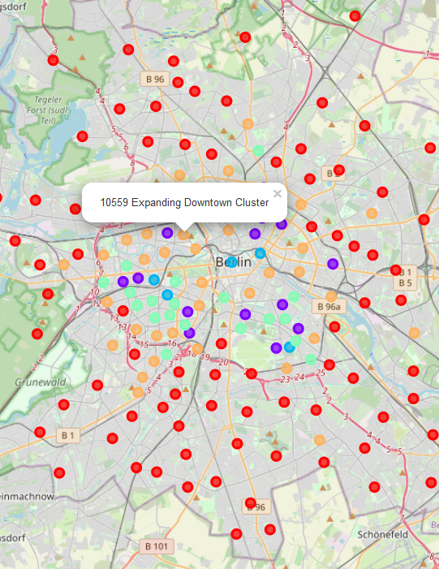
Using k-means to cluster the neighborhoods
Using the K-means algorithm we’ve arrived at 5 distinct clusters:
Tourist Traps - high in culture, recreation and shopping, mid-level in competition, not many children living in the area.
Wider Downtown - second highest concentration of places of culture, these places are just off the main tourist traps and could be a great place for a restaurant aimed at locals.
Food Central - largest concentration of competition, also highest in nightlife venues
Expanding Downtown - highest concentration of young adults, not too much competition, possible areas for downtown expansion
Residential - largest cluster with low sores in all venue types, highest concentration of retired residents and kids

Slide 5
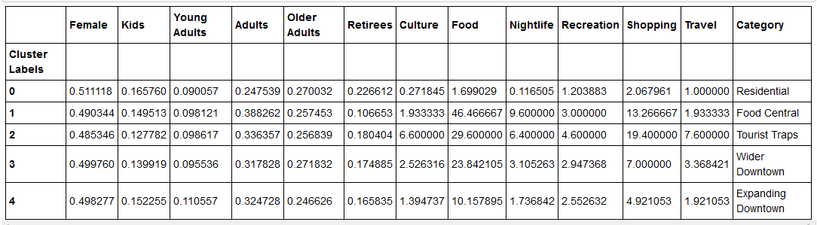
Feature averages for each cluster
Using these we’ve made observations about each cluster and labeled their categories

Slide 6
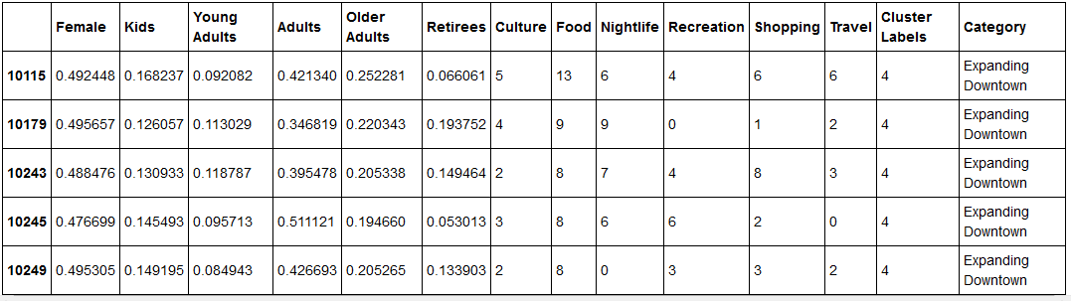
Detailed information for each postal code
The detailed data set can be used for quick analysis of any interesting venue listing.

Slide 7
Results and Conclusion
The neighborhood clusters serve to identify neighborhoods with a similar profile
This in turn can serve to quickly identify which neighborhoods have the characteristics desired by the user
The user can use the map to pick which neighborhoods would interest them in their search for a venue and then use the provided postal codes to filter the venue listings
Alternatively, they can use the postal codes of the available listings to cross-check the neighborhood profile in the detailed data set

